Slide 1
System Analysis
Work plan

Slide 2
Project Work plan
is a dynamic schedule that records and keeps track of all the tasks that need to be accomplished over the course of the project. The project manager first must assemble important
details about each task to be completed.
To create a work plan, the project manager identifies the tasks that need to be accomplished and determines how long each one will take. Then the tasks are organized within a work breakdown structure.

Slide 3
Identify Tasks
If a project manager prefers to begin from scratch, he or she can use a structured, top-down approach whereby high-level tasks are defined first and then broken down into subtasks. Each step is then broken down in turn and numbered in a hierarchical fashion. A list of tasks hierarchically numbered in this way is called a work breakdown structure, and it is the backbone of the project work plan. Figure 2-12 shows a portion of a work breakdown structure for the design phase of an actual data warehouse development project. Each of the main tasks focuses on one of the required design deliverables. Within each task, there are subtasks listed that detail the activities required to complete the main task.

Slide 4
The Project Work plan
The Project Work plan
The project work plan is the mechanism used to manage the tasks that are listed in the work breakdown structure. It is the project manager’s primary tool for managing the project. Using it, the project manager can tell whether the project is ahead of or behind schedule, how well the project was estimated, and what changes need to be made to meet the project deadline.

Slide 5
Basically, the work plan is a table that lists all the tasks in the work breakdown structure, along with important task information such as the people who are assigned to perform the tasks, the actual hours that the tasks took, and the variances between estimated and actual completion times (Figure 2-13). At a minimum, the information should include the duration of the task, the current statuses of the tasks (i.e., open, complete), and the task dependencies, which occur when one task cannot be performed until another task is completed. For example, Figure 2-13 shows that tasks 1.2 and 1.3 cannot begin until task 1.1 is completed. Key milestones, or important dates, are also identified on the work plan.

Slide 6
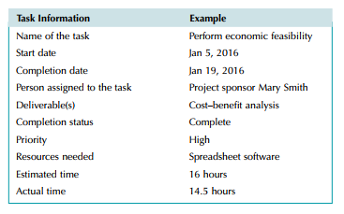

Slide 7
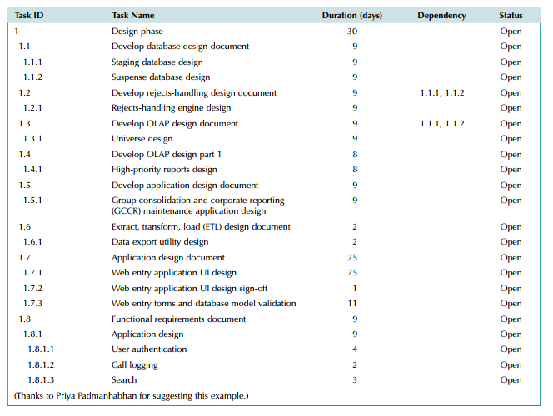

Slide 8
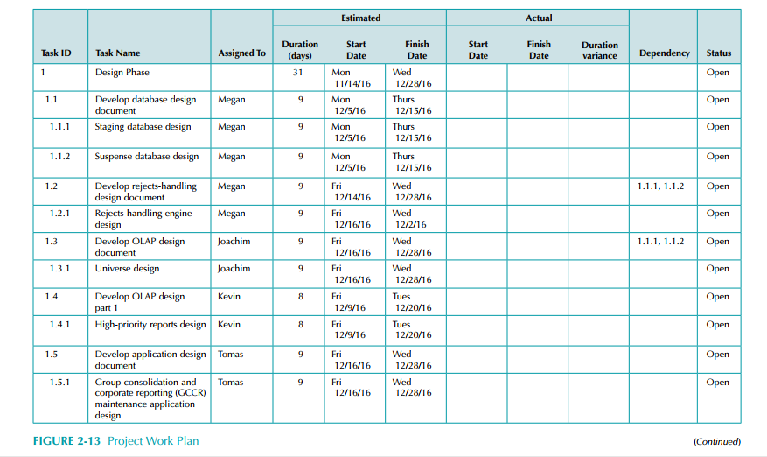

Slide 9
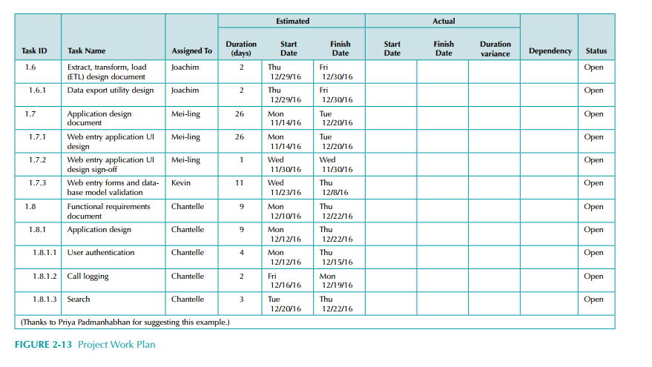

Slide 10
Gannt Chart
Gantt Chart
Bar chart format
Useful to monitor project status at any point in time

Slide 12
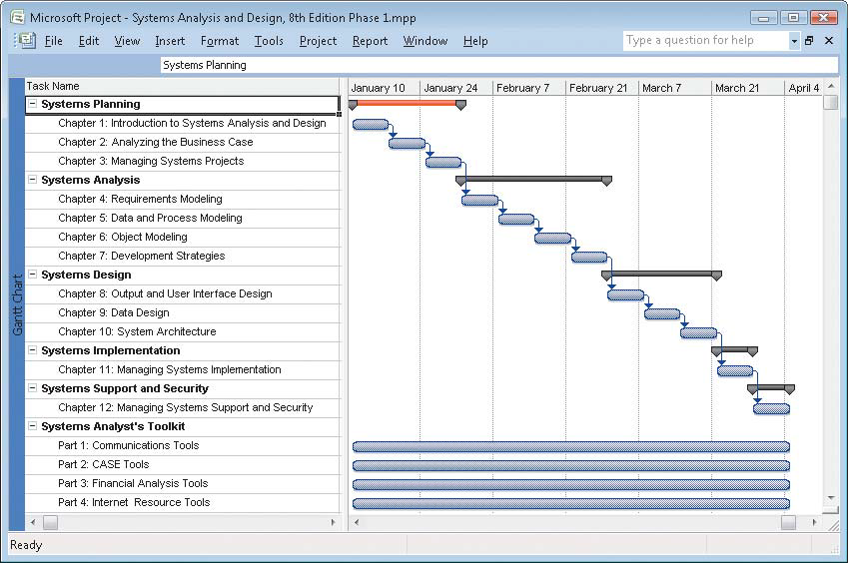

Slide 13
